Slide 1





Monitoring SUHU Kelembapan Tanah
MUROBBI AMINILLAH
211420078
IF5C

Slide 2



Komponen
Nodemcu ESP8266 Lolin
Breadboard Small
Capacitive Soil Moisture Sensor
Kabel Jumper
Komputer/Laptop Server (Database)

Slide 3
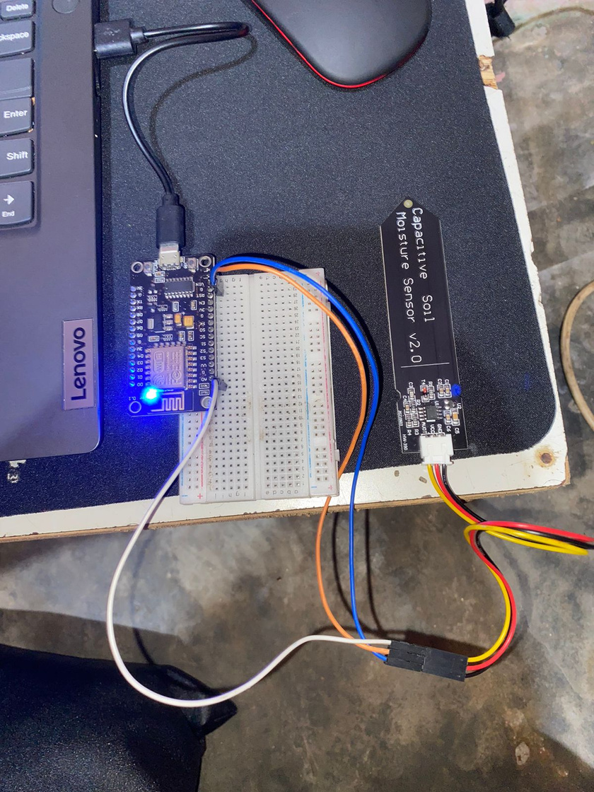
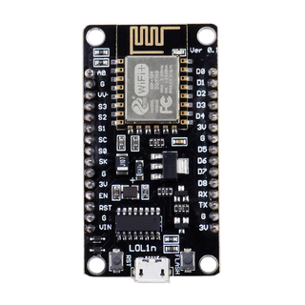
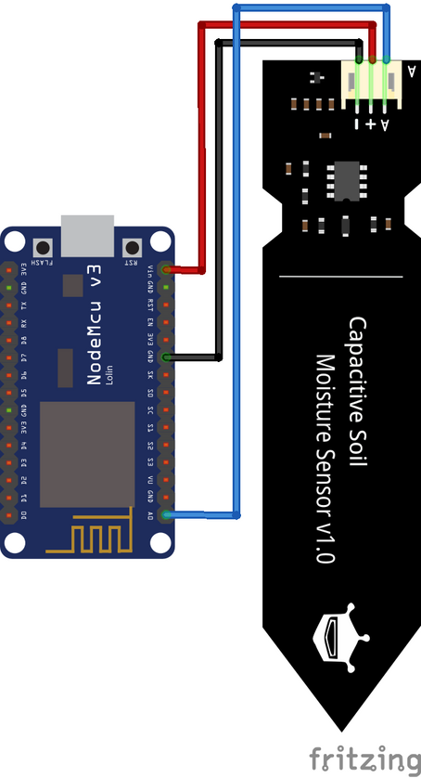
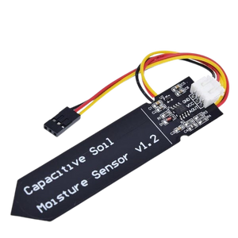

Rangkaian
Nodemcu ESP8266 Lolin
GND
GND
VIN
VCC
AO
AUOT
Capacitive Soil Moisture Sensor
GND
GND
VCC
VIN
AUOT
A0

Slide 4
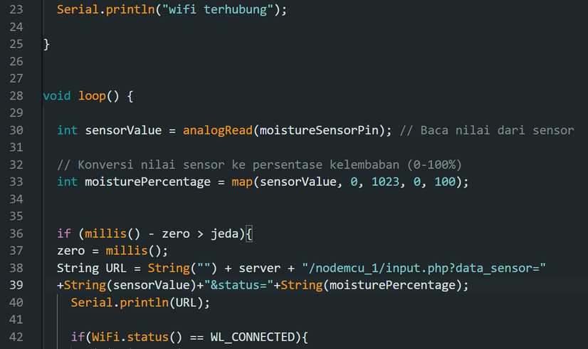
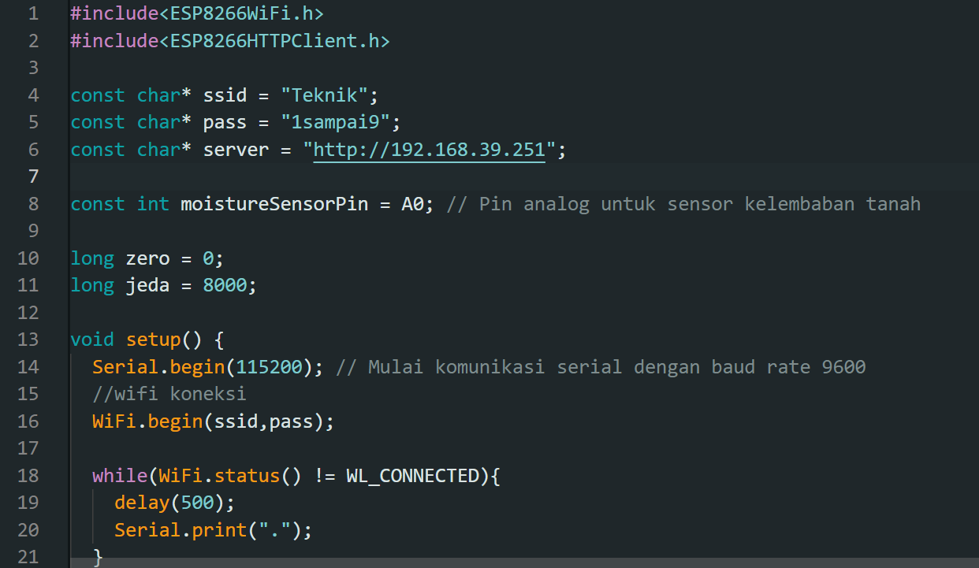
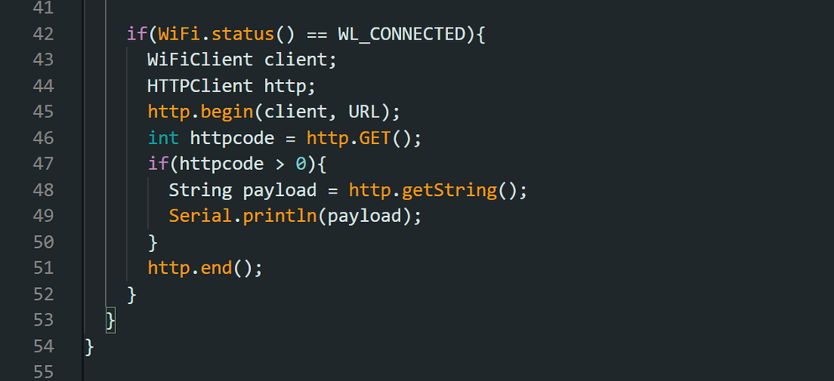

SOURCE CODE

Slide 5






DATABASE
TANGGAL
JAM
DATA SENSOR
STATUS

Slide 6
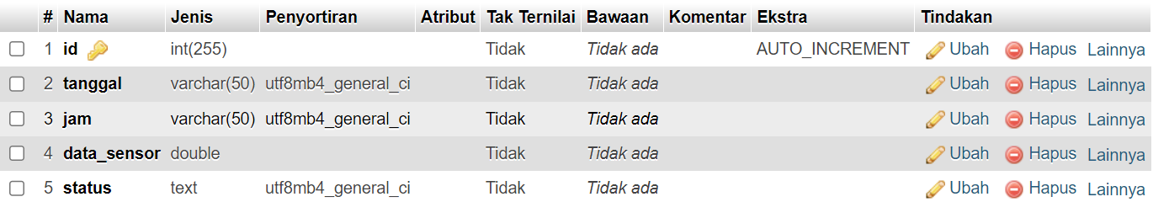
Database

Slide 7

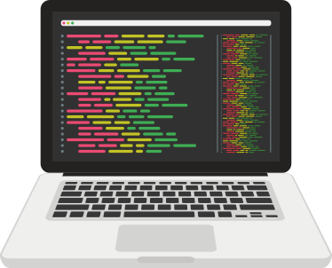

Murobbi
Aminillah
Thank You!

